Slide 1
Discussion Section (Week 12) NN and Deep Learning
CSCI 561 - Foundation for Artificial Intelligence
PROF WEI-MIN SHEN SHEN@ISI.EDU
.

Slide 2
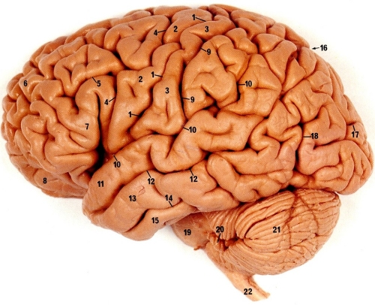
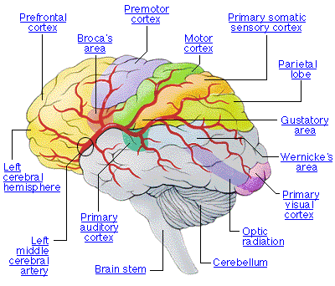
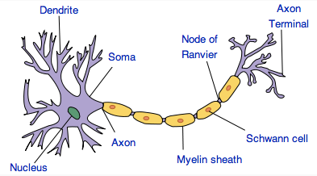
Real Neural Networks in Brain
Human brain is divided into regions with some functional specialization
E.g., Wernicke’s and Broca’s areas for language
Computation is driven by very large networks of rather slow neurons connected via synapses
10¹¹ neurons of > 20 types
10¹⁴ synapses
1-10ms cycle time
Signals are noisy spike trains of electrical potential
In AI/ML, models of neurons are highly simplified
New Discovery: Glial Cells in Brain boost learning

Slide 3
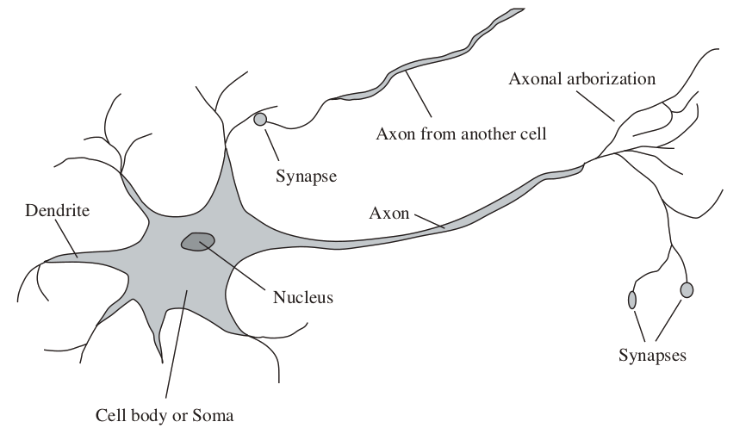
Artificial Neurons
Connectionism
Activation is passed along links from neuron to neuron
Neuron becomes a computational unit
Output is determined as a function of incoming activation
Input Activation Output

Slide 4
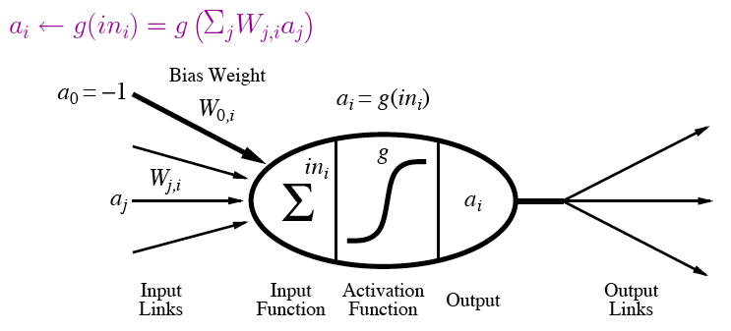
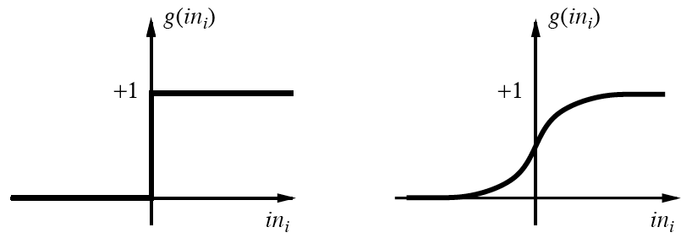
A modern view of “Units”
Output is a “squashed” linear function of inputs:
Activation function can be step/threshold or sigmoid
Bias weight sets threshold for linear threshold unit

Slide 5
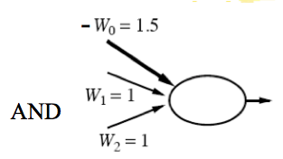
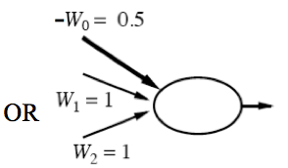
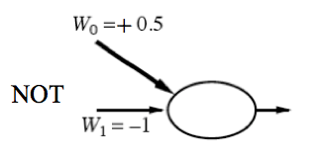
Implementing Logical Functions
Any Boolean function can be implemented in a network of linear threshold units (perceptrons)
But single layer networks are limited
E.g., cannot compute XOR
Minsky & Papert essentially killed off neural network field for a decade by showing this in 1969
Bias weight
Bias weight
Bias weight
1
x
y
Notes:
Ws are weights on inputs, not inputs.
Add all weighted inputs and see if >0

Slide 6
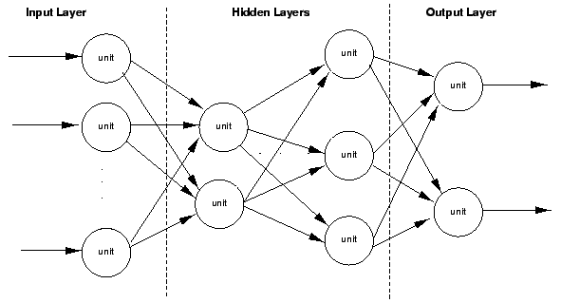
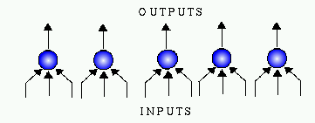
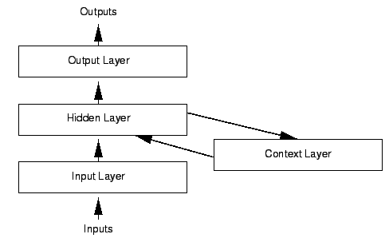
Variety of Network Structures
Feed-forward networks
May be single- or multi-layer
Implement functions/reflexes
No internal state
Recurrent networks
Directed cycles with delays
Internal state, like flip-flops
Dynamical systems
Hopfield networks
LTUs w/ symmetric weights
Minimize overall energy
Boltzmann machines
Stochastic, simulated annealing

Slide 7
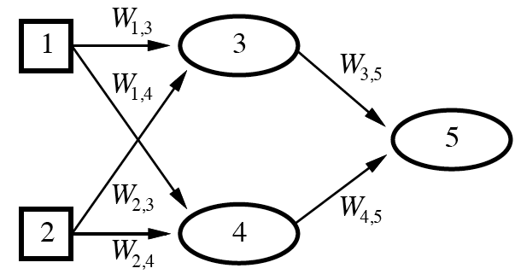
Feed-Forward Example
Feed-forward networks provide a parameterized family of nonlinear functions
a₅ = g(W_{3,5}a₃ + W_{4,5}a₄)
= g(W_{3,5}g(W_{1,3}a₁+W_{2,3}a₂) + W_{4,5}g(W_{1,4}a₁+W_{2,4}a₂))
Learning occurs by adjusting weights

Slide 8

Neural Network (exercise)
Draw the neural network to solve the XOR function for two inputs. Specify what type of unit you are using.

Slide 9
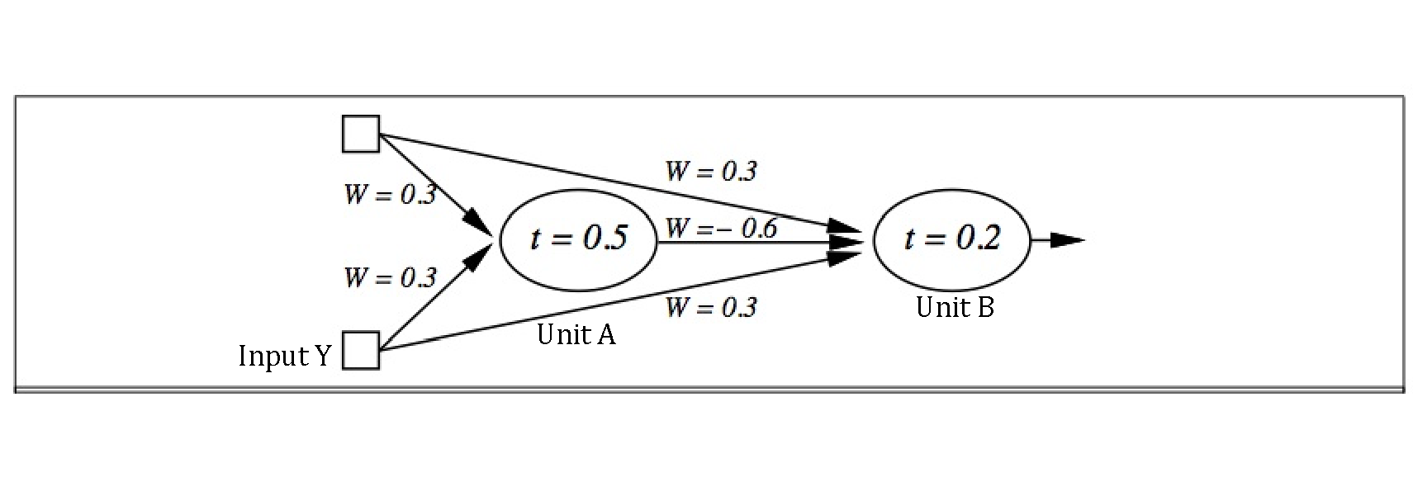
Input X
>0
When input X = 0 and input Y = 0, what does the Unit A output? What does the Unit B output?
When input X = 0 and input Y = 1, what does the Unit A output? What does the Unit B output?
When input X = 1 and input Y = 0, what does the Unit A output? What does the Unit B output?
When input X = 1 and input Y = 1, what does the Unit A output? What does the Unit B output?
What Boolean function does this Neural Network compute?

Slide 10
Perceptron Learning
Learn by adjusting weights on each iteration to reduce error
Gradient descent on squared error (y - out)²
Update rule for weights of a threshold function:
W_{j}’ = W_{j} + α (y - out) x_{j}
Comparable rules exist for differentiable activation functions
This perceptron learning rule is guaranteed to converge to a consistent function if the data is linearly separable
x₁
y
W₁
x₂
out
W₂
x₃
W₃
Notes:
y is the correct value on example x
out is the output of the neuron on example x
α is the learning rate
x_{j} is the value of the jth input to x (only modify weight if it actually contributed)
Modify weight according to the degree of error

Slide 11
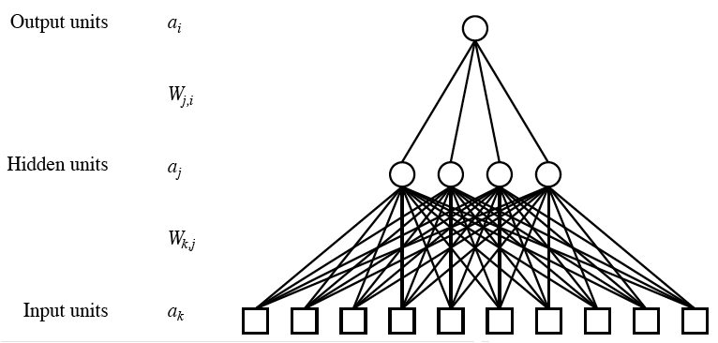
Multilayer Neural Networks
Units typically fully connected across layers unless have domain-specific knowledge to guide
Number of hidden units either chosen by hand or found via search
If too many, network will memorize input (overfitting)
If too few, function will be difficult to represent
As with Goldilocks, need it just right (to generalize)

Slide 12
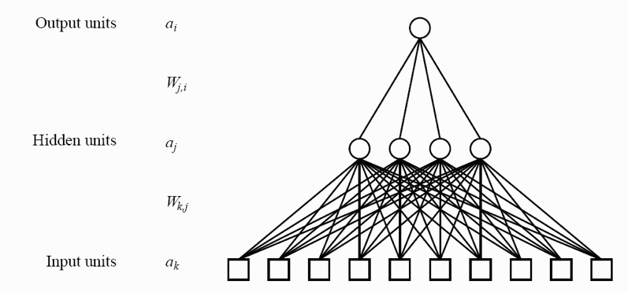
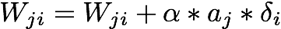
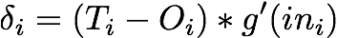
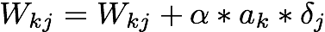
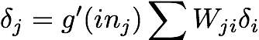
Multilayer network Learning (Back-Propagation)

Slide 13
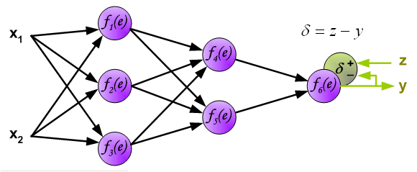
Example of Back-propagation

Slide 14
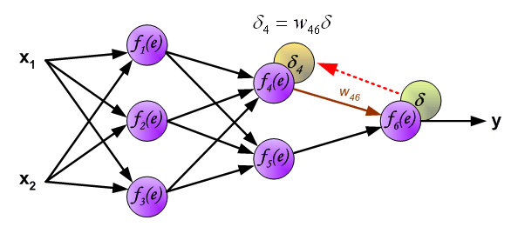
Example of Back-propagation

Slide 15
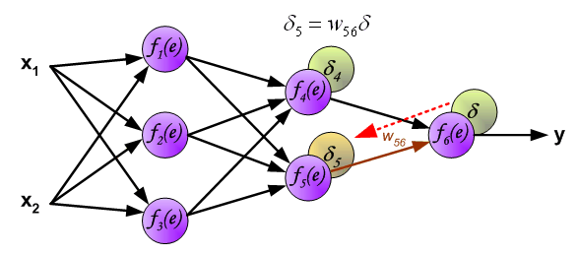
Example of Back-propagation

Slide 16
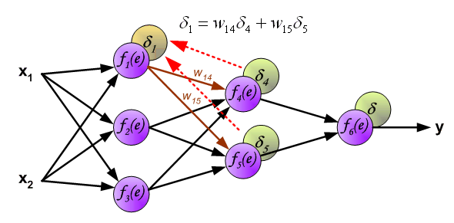
Example of Back-propagation

Slide 17
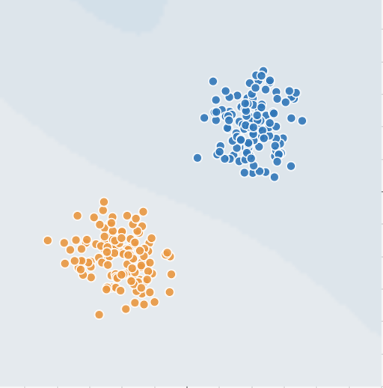
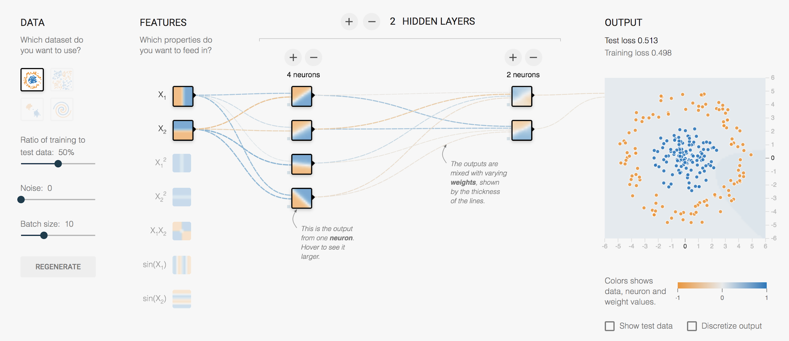
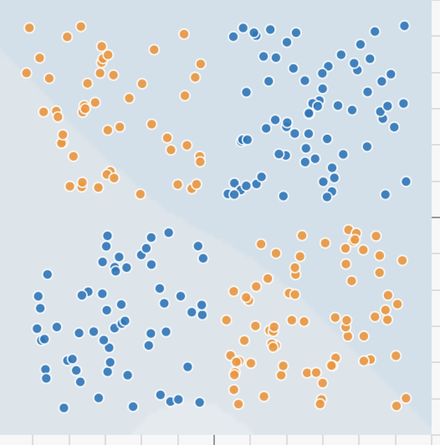

Google’s Neural Network Playground
https://www.playground.tensorflow.org/

Slide 18
Deep Learning (Discussion)

Slide 19

Buzz…

Slide 20

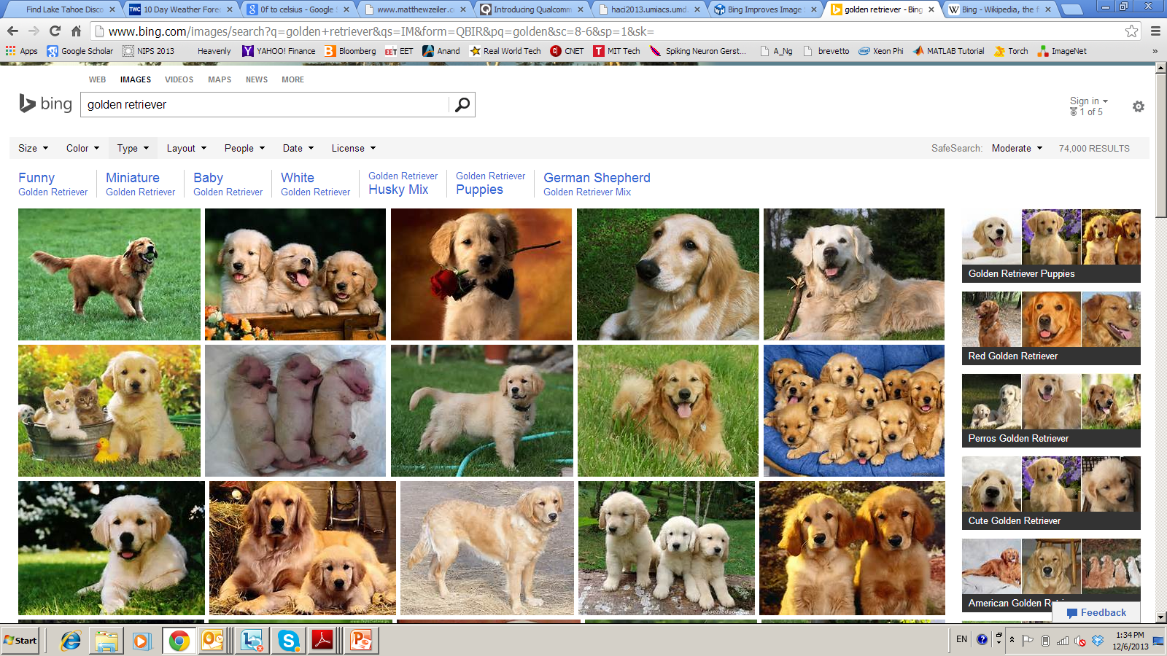



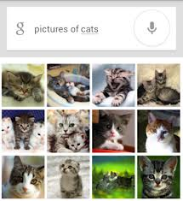

Deep Learning Applications
Deep Learning - breakthrough in visual and speech recognition

Slide 21
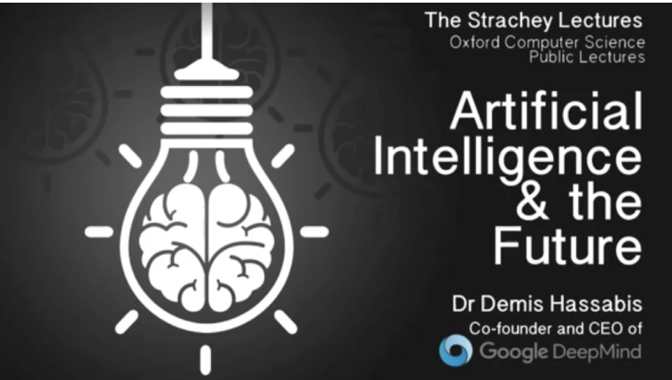
Deep Mind (Learn to Play Game Go)

Slide 22

Classical Computer Vision Pipeline.
CV experts
Human select / develop features: SURF, HoG, SIFT, RIFT, …
Add on top of this Machine Learning for multi-class recognition and train classifier
Feature
Extraction:
SIFT, HoG...
Detection,
Classification
Recognition
Classical CV feature definition is domain-specific and time-consuming

Slide 23
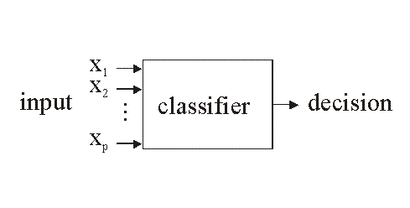
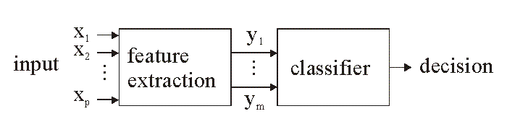
Vision: Classic vs. Deep-Learning
Human
designed
features
ML designed
features
Raw images
(No features)
http://www.electronicsletters.com/papers/2001/0020/paper.asp

Slide 24
Deep Learning Vision Pipeline.
Deep Learning:
Build features automatically based on training data
Combine feature extraction and classification
DL experts: define NN topology and train NN
Deep NN...
Deep NN...
Detection,
Classification
Recognition
Deep Learning promise:
train good feature automatically,
same method for different domain

Slide 25



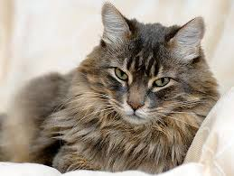


Deep Learning Basics
Deep Learning – is a set of machine learning algorithms based on multi-layer networks
CAT
DOG
Training

Slide 26

Deep Learning Basics
Deep Learning – is a set of machine learning algorithms based on multi-layer networks
CAT
DOG

Slide 27
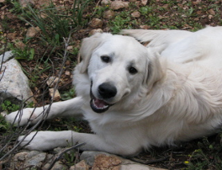
Deep Learning Basics
Deep Learning – is a set of machine learning algorithms based on multi-layer networks
CAT
DOG

Slide 28
Deep Learning Taxonomy
Supervised:
Convolutional NN ( LeCun)
Recurrent Neural nets (Schmidhuber )
Unsupervised
Deep Belief Nets / Stacked RBMs (Hinton)
Stacked denoising autoencoders (Bengio)
Sparse AutoEncoders ( LeCun, A. Ng, )

Slide 29
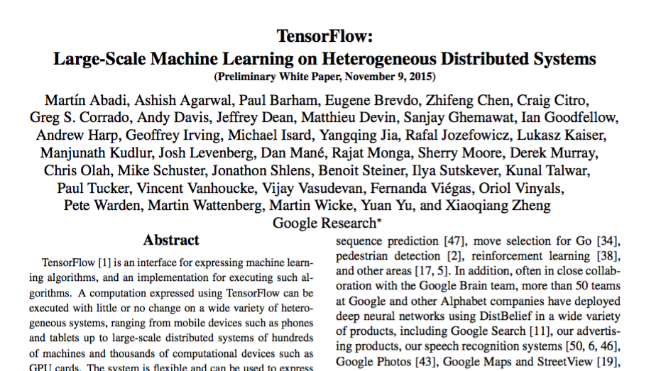
Google’s TensorFlow Algorithm (highly recommended)

Slide 30
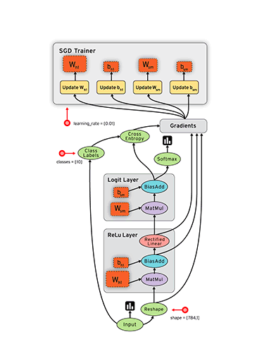
TensorFlow Graph

Slide 31
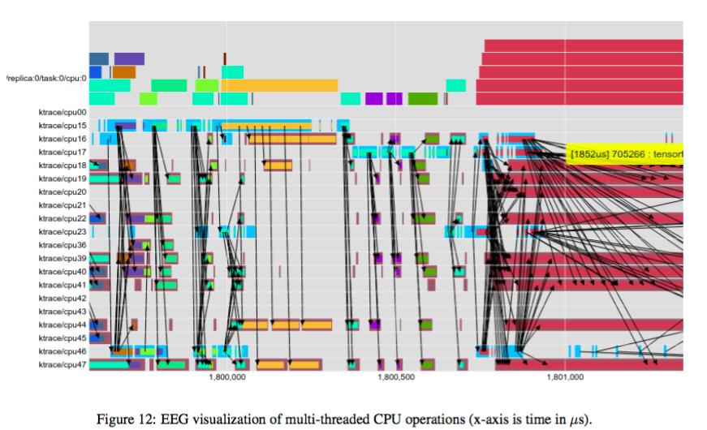
TensorFlow Highlights

